Slide 1

AFL Game Predictor using Machine Learning
Final Project.
Presented by :
Tamer Abdelaal, Sam Portelli & Samir Barua

Slide 2
Project Outline
We are an AFL Consultancy Company, who have been commissioned by the AFL to prepare a high-level analysis of Football Game Statistics to understand team and player performance and to be able to predict outcomes in future matches.
We have decided to use machine learning to develop a prediction model for game outcomes and to provide visualisation tools to identify game statistics which determine outcomes of games using a number of statistical variables involving teams, players, rain, venue, and other items.

Slide 3
Data Sources
Kaggle website: https://www.kaggle.com/stoney71/aflstats
original sources for the above data: afltables.com and www.footywire.com
Article: Machine Learning in AFL Part II - It's all about the percentages : AFL (reddit.com)

Slide 4
Data Sources
Metadata:
games.csv (12 Fields)
5 more fields for modelling
Gameid | Year | Round | Date
Venue | Start Time | Attendance | Home Team
Home Team Score | Away Team | Away Team Score | Rainfall
Wining Team | Wining Margin | Winning Margin Percent | Home Team Points | Away Team Points

Slide 5
Data Sources
Metadata:
stats.csv (31 Fields)
Gameid | Team | Year | Round
Playerid | Display Name (Player) | Game Number | Disposals
Kicks | Marks | Handballs | Goals
Behinds | Hit Outs | Tackles | Rebounds
Inside 50s | Clearances | Clangers | Frees
Frees Against | Brownlow Votes | Contested Possessions | Uncontested Possessions
Contested Marks | Marks Inside 50 | One Percenters | Bounces
Goal Assists | % Played | Subs

Slide 6
Data Source
Metadata:
players.csv (7 Fields). This data was not used for this application, but would be considered for a future update.
Playerid | Display Name (Player) | Height | Weight
Dob | Position | Origin

Slide 7
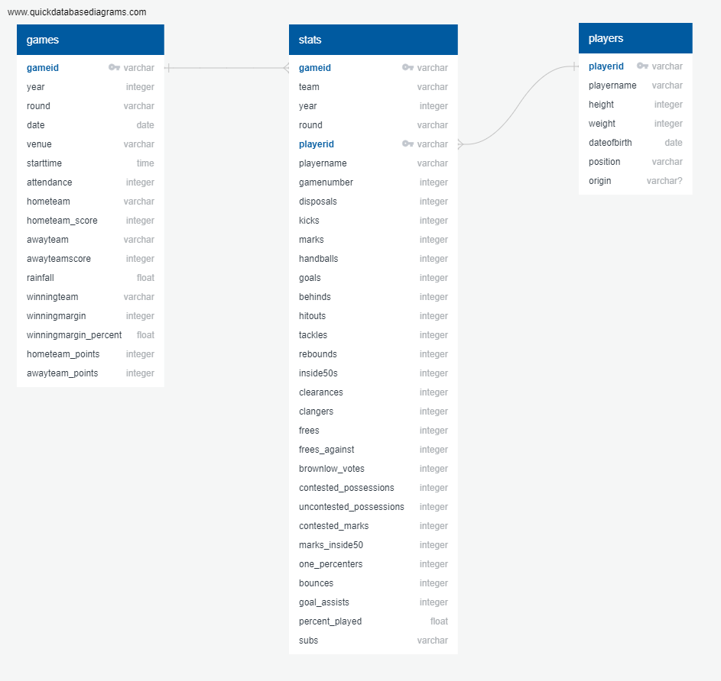
Entity Relationship Diagram

Slide 8
Application Functionality
To use past AFL game statistics to create a predictive model for AFL game outcomes in the future, using machine learning
To demonstrate the model’s effectiveness by showing a past season’s predictions versus the actual results for a historical nominated round e.g. the actual versus prediction for Round 1 games of 2021, Round 20 of 2021.
To prepare game predictions for Round 1 of the new season 2022.
To provide comparative statistics of nominated teams via a Tableau dashboard, embedded into the web application.

Slide 9
Application Development - Postgres
Postgres was used to store and model the afl statistics datasets into a database
The data was then summarized and transformed to create records suitable for modelling i.e. 5-game averages and % differences between teams
Transformed data made available to Python for modelling via SQLAlchemy.

Slide 10
Application Development – Python
Python via Jupyter notebook with SKLearn (machine learning) modules was used to read and model data directly from the Postgres database.
We applied a number of machine learning models to determine which variables were the most significant and which model gave us the best outcome – H2O.AutoML was chosen for our games predictor.
We created a predicted outcomes dataset for all past games since R5 of 2012 and Round 1 of 2022 for use in the web application.

Slide 11
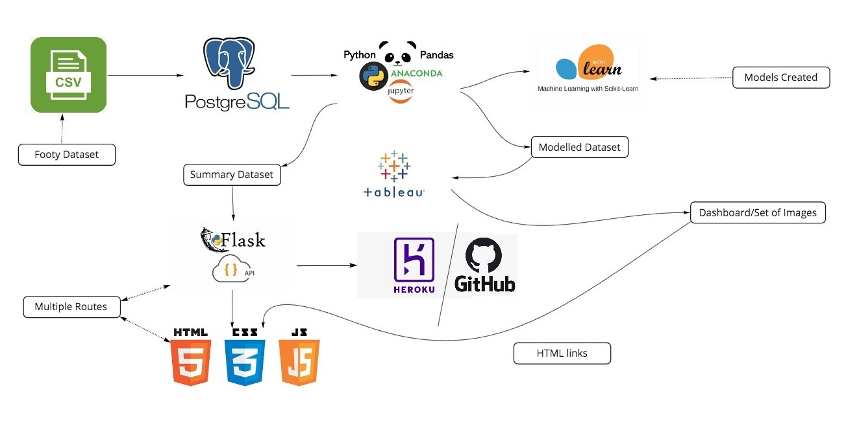
Application Design

Slide 12
Features – Machine Learning
Based on rolling 5 game statistics
In-game statistics differential The average statistics from the previous 5 games were determined for each game to form a game record for modelling. These were determined for both teams playing in a match. The % differences relative to the home team were saved for modelling purposes together with the outcome of the match
Team points (for wins), win_loss indicator (for home team), home/away indicator
Player statistics: disposals, kicks inside50s, clearances, contested possessions, contested marks, marks_inside50 & goal assists.

Slide 13
Application Development - ML
Models tested: Random Forest, Logistic Regression, Linear Regression & H2O.AutoML.
Note: H2O automatically creates many models, tunes each one and returns the best model with the highest/lowest metric. It got an F1 Score of 0.69! The closer F1 is to 1, the better the model. F1 is a measure of a test's accuracy, calculated from the precision and recall of the test
Evaluation Metrics:
Accuracy: 0.5843765648472709 Recall: 0.9113475177304965
F1 Score: 0.6842906047926969 Precision: 0.5478075517661388 Confusion Matrix: TN, FP, FN, TP [ 535 1485 175 1799]

Slide 14
Application Development - ML
Variable Importances (via H2O):
 | variable | relative_importance | scaled_importance | percentage
0 | inside50s | 0.342433 | 1.000000 | 0.302427
1 | team_points | 0.331436 | 0.967885 | 0.292715
2 | contested_possessions | 0.198784 | 0.580505 | 0.175561
3 | marks_inside50 | 0.168111 | 0.490931 | 0.148471
4 | disposals | 0.036104 | 0.105434 | 0.031886
5 | kicks | 0.032543 | 0.095035 | 0.028741
6 | goal_assists | 0.022871 | 0.066789 | 0.020199

Slide 15
Application Development – Front end
The application was developed using Flask with a number of web pages for each functional feature (routes).
The model prediction feature accesses a dataset based on selected filters i.e. year, round and team. This functionality makes use of javascript working with the routes.
The flask application was uploaded to the github repository and deployed using Heroku.

Slide 16
Application Development – Tableau
With the modelled dataset (CSV format), Tableau charts were created for a number of team games statistics for the seasons from 2012 – 2021.
Charts arranged on a dashboard with filtering fields for Year, Team and Rounds for team comparison.
Link for the dashboard was embedded in html for user interactivity with Tableau through our website.

Slide 17
Conclusion
It was a challenging exercise to be able to use source data and transform it to acceptable input data for the machine learning models.
Learning which data is more important was part of the process to refine the models – an iterative process.
Without the limitation of time we would certainly consider additional variables (features) for the model(s), to progressively improve the accuracy.

Slide 18
Conclusion – contd.
Further improvements could include:
the ability to do what/if modelling where statistical data is entered/changed to see what the outcome will be.
determining the results of multiple future rounds, assuming predicted outcomes for prior rounds – even to predict the grand final winner!
Create multiple dream teams with selected players and model their predicted game outcome!
Comparison of player performance and their impact on game outcomes – even to predict the Brownlow winner!

Slide 19
Presentation of our App!
Link: https://afl-game-prediction-model.herokuapp.com/

Slide 20
THE END

